Slide 1
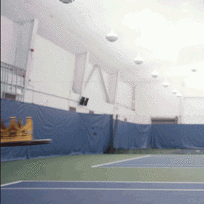
You Made It!

Slide 2
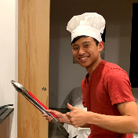
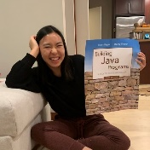
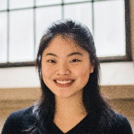
Thank your TAs

Slide 3
Learning Objectives
or, “What will I learn in this class?”
Functionality/Behavior: Write functionally correct and efficient Java programs and systems of medium to large length and complexity that meet a provided specification and/or solve a specified problem
Comprehension: Trace and predict the behavior of programs and systems
Data Abstraction: Select and apply appropriate abstract data types to manage program state
Data Structures: Design, implement, and modify data structures to efficiently and effectively provide a defined set of operations
Functional Abstraction: Document, maintain, and utilize appropriate abstractions between the implementer and client of a library
Decomposition: Solve problems by breaking them into subproblems and recombining the solutions using techniques such as methods, inheritance, and recursion
Code Quality: Define programs that are well-written, readable, maintainable, and conform to established standards

Slide 4
Road Map
CS Concepts
Client/Implementer
Efficiency
Recursion
Regular Expressions
Grammars
Searching / Sorting
Backtracking
Hashing
Huffman Compression
Data Structures
Lists
Stacks
Queues
Sets
Maps
Priority Queues
Java Language
Exceptions
Interfaces
References
Comparable
Generics
Inheritance / Polymorphism
Abstract Classes
Java Collections
Arrays
ArrayList 🛠
LinkedList 🛠
Stack
TreeSet / TreeMap 🛠
HashSet / HashMap 🛠
PriorityQueue

Slide 5
Comparison to CSE 142 (or similar)
CSE 142
CSE 143
Control structures
Simple (primitive) data
Client view
Java as focus
How do I do this?
Data structures
Complex data
Implementer view
Java as example
What can I do with this?

Slide 6
Underlying Skills
or “What did I learn in this class without realizing it?”
Abstraction
Leverage existing components without understanding details
Create components that can be used as black boxes
Problem solving
Decomposing a large problem into smaller ones
Design tradeoffs
Algorithm analysis - scalability and growth
Keeping code easy to read for maintainability
Recursive thinking
Reason about problems in terms of self-similarity
Write very short code to achieve complex behaviors

Slide 8
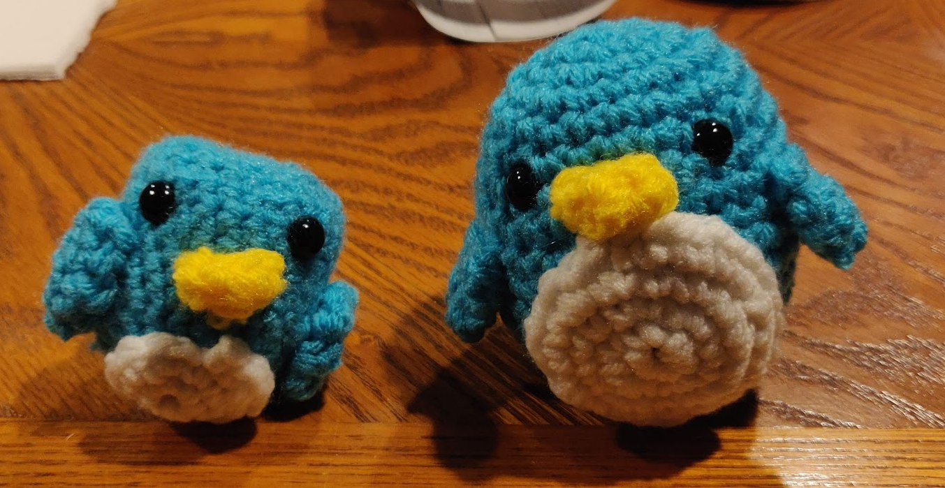
Digression: My New Hobby
Amigurumi: Japanese art of creating crocheted or knitted stuffed toys

Slide 9
Applications of CS
or “What can I do with what I learned?”
Detect and prevent toxicity online
Digitize basketball players
Help DHH people identify sounds
Figure out how to best distribute relief funds
Recognize disinformation online
Make movies
Improve digital collaboration
Fix Olympic badminton
And so much more!

Slide 10
Future Courses
or “What can I do next?”
Majors
Non-majors
Course | Overview
CSE 311 | Mathematical foundations
CSE 351 | Low-level computer organization/abstraction
CSE 331 | Software design/implementation
CSE 341 | Programming languages (!)
CSE 340 | Interaction programming
Course | Overview
CSE 154 | Intro. to web programming (several languages)
CSE 163 | Intermediate programming, data analysis (Python)
CSE 180 | Introduction to data science (Python)
CSE 373 | Data structures and algorithms (non-majors)
CSE 374 | Low-level programming and tools (C/C++)
CSE 416 | Intro. to Machine Learning
All offered Spring 2021
See: https://www.cs.washington.edu/academics/ugrad/current-students and https://www.cs.washington.edu/academics/ugrad/nonmajor-options/nonmajor-courses

Slide 11
Frequently Asked Questions
How can I get better at programming?
Practice!
How can I learn to X?
Search online, read books, look at examples
What should I work on next?
Anything you can think of! (Here are some ideas)
Beware: it’s hard to tell what’s easy and what’s hard.
Should I learn another language? Which one?
That depends– what do you want to do?
What’s the best programming language?
😠 (take CSE 341)

Slide 12
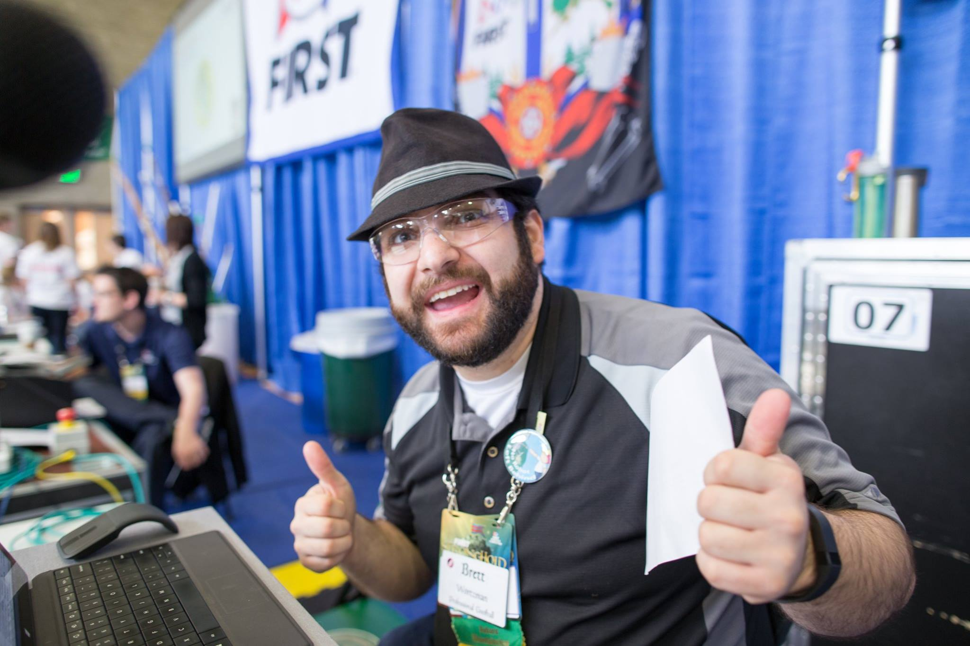
Thank you!!!
Ask Me (Almost) Anything!

